Slide 1
DEPARTMENT OF MECHANICAL ENGINEERING SUB CODE -18MES103L SUB.NAME-BASIC CIVIL & MECHANICAL ENGINEERING WORKSHOP
EXPERIMENT 4
STEP MAKING

Slide 2
FITTING-INTRODUCTION
Manufacturing processes are broadly classified into four categories; (i) Casting processes,(ii)Forming processes, (iii) Fabrication processes, and (iv) Material removal processes.
In all these processes, components are produced with the help of either machines or manual effort.
The attention of a fitter is required at various stages of manufacture starting from marking to assembling and testing the finished goods.
Working on components with hand tools and instruments, mostly on work benches is generally referred to as ‘Fitting work’.
The hand operations in fitting shop include marking, filing, sawing, scraping, drilling, tapping, grinding, etc., using hand tools or power operated portable tools.
Measuring and inspection of components and maintenance of equipment is also considered as important work of fitting shop technicians.

Slide 3
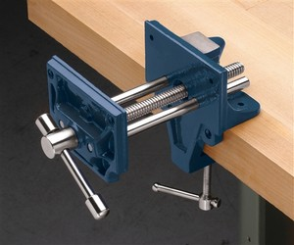
TOOLS USED – WORK HOLDING TOOLS
Bench Vice
The bench vice is a device commonly used for holding the work pieces.
When the vice handle is turned in a clockwise direction the moving jaw forces the work against the fixed jaw.
The greater the pressure applied to the handle, the tighter is the work held.
The body of the vice is made of cast- iron. Hardened steel plates with serrations to ensure better gripping of the work are fixed on the faces of the two jaws.
Jaw caps made of soft material such as aluminium or galvanised iron (G.I) sheet are used to protect finished surfaces of the work gripped in the vice. Vices are specified by the maximum width that can be held or the maximum opening between the jaws, varying from 75 mm to 300 mm.

Slide 4
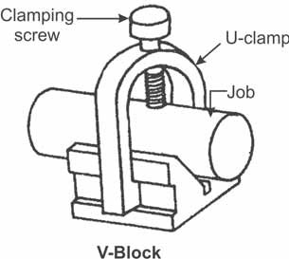
V Block with clamp
The V-block is a rectangular or square block with a V- groove on one or both sides, opposite to each other.
The angle of the V is usually 90º. V-block with a clamp is used to hold cylindrical work securely, during marking of measurements or for measuring operations.
Material: C.I or hardened steel. Size: 50 to 150 mm.

Slide 5
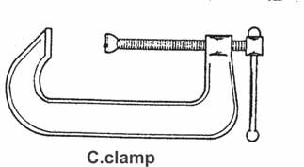
C-Clamp
This is used to hold work against an angle plate or V-block or any other surface, when gripping is required. It is also known as G-clamp.

Slide 6
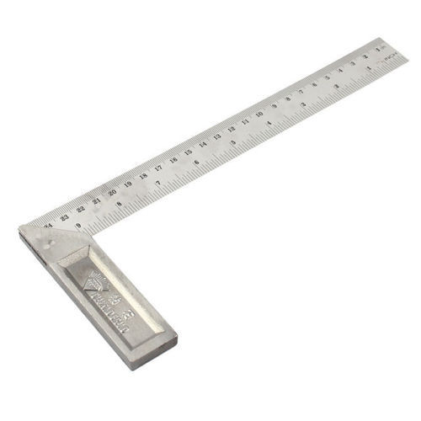
MARKING TOOLS-Try Square
A try- square is a woodworking tool used for marking and measuring a square piece of wood.
The square refers to the tool's primary use of measuring the accuracy of a right angle (90 degree angle); to try a surface is to check its straightness or correspondence to an adjoining surface.

Slide 7
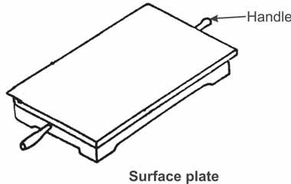
SURFACE PLATES
The surface plate is used for testing the flatness of the work piece and other inspection purposes.
It is also used for marking on small works.
It is more precise in flatness than the marking table.
Surface plates are made of C.I. or hardened steel, ground and scraped to the required precision.
Now-a-days surface plates made of special granite stone are manufactured in wide range of precision grades, colours and sizes.
It is specified by length × width × height × grade. Example: 600 × 400 × 100 × grade A has a flatness upto 0.005 mm.

Slide 8
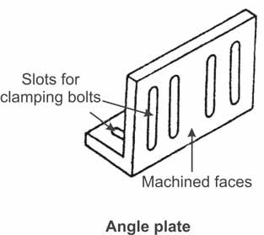
ANGLE PLATES
The angle plate is made of cast iron.
It has two surfaces machined at right angles to each other.
Plates and components which are to be marked out may be held against the upright face of angle plate to facilitate the marking or inspection

Slide 9
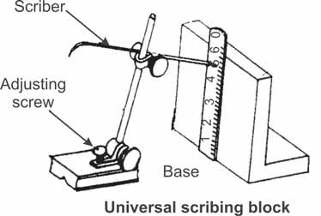
UNIVERSAL SCRIBING BLOCK
This is used for scribing lines for layout work and checking parallel surfaces.

Slide 10
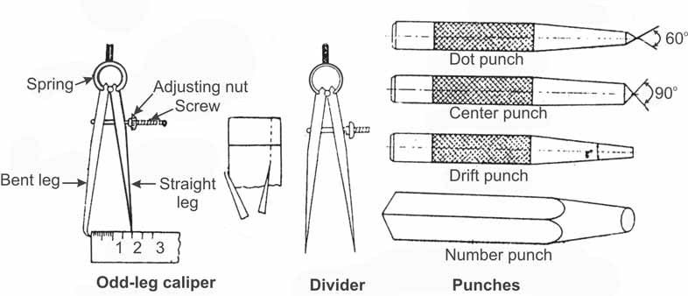
DIVIDER
This is used for marking circles, arcs, laying out perpendicular lines, bisecting lines, etc. Size ranges from 100 mm to 300 mm.

Slide 11
DOT PUNCHES
This is used for marking circles, arcs, laying out perpendicular lines, This is used to locate centre of holes and to provide a small centre mark for divider point etc.
For this purpose, the punch is ground to a conical point having 60º included angle.
Centre punch
This is similar to the dot punch, except that it is ground to a conical point having 90° included angle.
It is used to mark the location of the centre where holes are to be drilled.
The centre punch mark facilitates easy location of the drill tip and centre accurately.
Drift punch
A drift punch is a long tapered tool used to align holes in two or more pieces of material that are to be joined together, so that bolts or rivets can be easily placed in the holes.

Slide 12
DOT PUNCHES
Letter punch
It has square body with a tapered end. At this end, a projection, corresponding to the replica of the letter to be marked is made.
The letters used are A to Z, and symbol totaling 27 numbers.
Number punch
It is similar to letter punch in construction but has numbers at its end. The numbers used are from 0 to 8 (six used as nine also).
Punches are made of tool steel, hardened and tempered.
bisecting lines, etc. Size ranges from 100 mm to 300 mm.

Slide 13
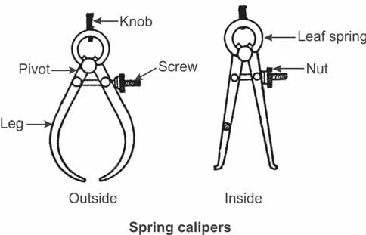
MEASURING TOOLS-CALIPER
These are used with the help of steel rule to check outside and inside measurements.
They are specified by the maximum length measured. Sizes vary from 100 mm to 300 mm.

Slide 14
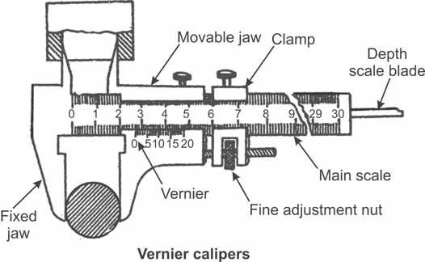
MEASURING TOOLS-VERNIER CALIPER
These are used for measuring outside as well as inside dimensions accurately.
It may also be used as a depth gauge.
In the figure shown, 19 main scale divisions are divided into 20 equal parts in the vernier scale. Hence, least count of the vernier = 1 main scale division – 1 vernier scale division = 1 – 19/20 = 0.05 mm.
The size is specified by the maximum measurement it can make ranging from 150 to 300 mm.
The accuracy of the instrument depends on the least count, varying from 0.1 to 0.02.
Other types of verniers include dial vernier, digital vernier with more accuracy etc.

Slide 15
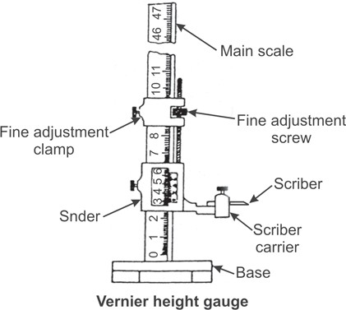
MEASURING TOOLS-VERNIER HEIGHT GAUGE
The vernier height gauge, clamped with a scriber, is shown in figure. It is used for layout work.
An offset scriber is used when it is required to take measurements from the surface, on which the gauge is standing.
The accuracy and working principle of the gauge are the same as those of the vernier caliper.
The capacity of the height gauge is specified by the maximum height it can measure. It varies from 150 mm to 1000 mm.

Slide 16
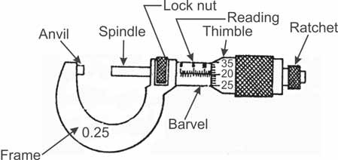
MEASURING TOOLS-OUTSIDE MICROMETER
This is used for measuring external dimensions accurately.
Figure shows a micrometer of 0 to 25 mm range with an accuracy of 0.01 mm.
These are available in different ranges with interchangeable anvils varying from 0-25 mm to 2000 mm in sizes and 0.01 to 0.001 in accuracy.
There are many types of micrometers designed for special purpose use.
They include thread micrometers to measure thread dimensions,tube micrometers to measure wall thickness of tubes, etc.

Slide 17
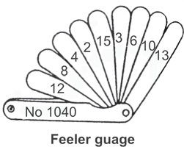
MEASURING TOOLS-FEELER GAUGE
The thickness gauges or feeler gauges are a set of gauges consisting of thin strips of metal of varying thickness.
They are widely used for measuring and checking bearing-clearance, adjusting tappets, spark plug gaps, and so on.
The thickness varies from 0.05 to 0.5 mm.

Slide 18
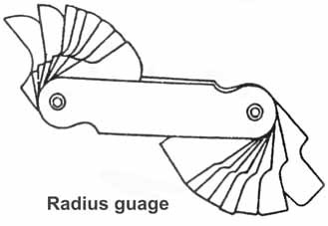
MEASURING TOOLS-RADIUS GAUGE
Also known as fillet gauges, these are of thin flat steel tool used for inspecting and checking, or laying out work having a given radius.
Such a gauge is made in sets of individual gauges for measuring concave (internal) or convex (external) radius.

Slide 19
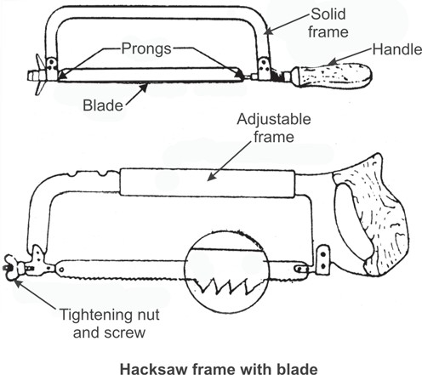
CUTTING TOOLS –HACK SAW
The hacksaw is used for cutting metal by hand.
It consists of a frame which holds a thin blade, firmly in position. The blade has a number of cutting teeth.
The number of teeth per 25 mm of the blade length or teeth per inch (TPI) is selected on the basis of the work material and thickness (Table 1) being cut.
Figure shows two types of hacksaw frames with a blade fixed.
The teeth of the hacksaw blade are staggered, as shown in figure which is known as “set of teeth”.
These make the slots wider than the blade thickness, preventing the blade from jamming.’

Slide 20
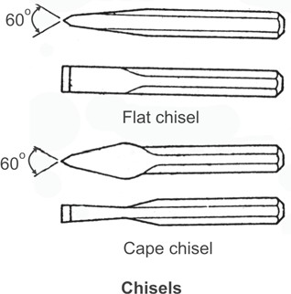
CUTTING TOOLS –CHISELS
Chisels are used for removing surplus metal or for cutting thin sheets.
These tools are made from 0.9% to 1.0% carbon steel of octagonal or hexagonal section.
Chisels are annealed, hardened and tempered to produce a tough shank and a hard cutting edge.
Annealing relieves the internal stresses in the metal.
The cutting angle of the chisel for general purpose is 60 degrees.
A flat chisel is a common chisel used for chipping and cuffing off thin sheet-metal.
A cape chisel is narrow shaped tool.
It is cased mostly for the chipping grooves and keyways.

Slide 21
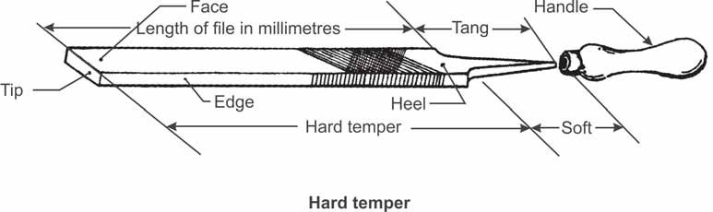
FINISHING TOOLS –FILES
Filing is one of the methods of removing small amounts of material from the surface of a metal part.
A file is a hardened steel tool, having slant parallel rows of cutting edges or teeth on its surfaces.
On the faces the teeth are usually diagonal to the edge.
One end of the file is shaped to fit into a wooden handle.
Figure shows the parts of a hand file.
The hand file is parallel in width and tapering slightly in thickness, towards the tip.
It is provided with double cut teeth on the faces, single cut on one edge and no teeth on the other edge, which is known as the safe edge.

Slide 22
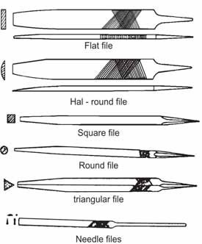
FINISHING TOOLS –TYPES OF FILES
Hand file
Rectangular in section and tapered in thickness but parallel in width.
The faces carry double cut teeth and one of the edges single cut.
The other edge, known as safe edge, does not have any teeth and hence this file is also known as safe edge file.
It is useful in filing a surface which is at right angles to an already finished surface.
Flat file
It is rectangular in section and tapered for 1/3 length in width and thickness towards the tip.
The faces carry double cut teeth and the edges carry single cut teeth. It is a general purpose file.

Slide 23
FINISHING TOOLS –TYPES OF FILES
Square file It is square in section and carry double cut teeth on all the four faces.
It is tapered for 1/3 of its length towards the point. Square files are used for filing corners and slots.
It is also used to cut keyways.
Three square file It is of equilateral triangular in section and tapers towards the tip.
The faces are double cut and the edges sharp. These files are used to file angular hole, and recesses. Used for sharpening wood saws.
Round file It is tapered for 1/3 length with double cut on large coarse grades.
Used for filing out round, elliptical and curved openings.

Slide 24
FINISHING TOOLS –TYPES OF FILES
Half round file The half round file has one flat and one curved side. The flat side is double cut and the curved side is single cut. It is not a semicircle but only about 1/3 of circle. Second cut and smooth grades are used. This is an extremely useful double purpose file for flat surfaces and for curved surfaces which are too large for the round file to be used.
Swiss or Needle files 150 mm long with double cut teeth. Used for filing corners, grooves, narrow slots, etc.
Cut refers to ‘single cut’ and ‘double cut’ files. Single cut files have rows of teeth running in one direction, across their faces and double cut files have a second row of teeth cut diagonally to the first row as shown. Single cut files are used with light pressure to produce smooth finish. These are widly used for finishing over turning jobs.

Slide 25
FINISHING TOOLS –FILEGRADES

Slide 26
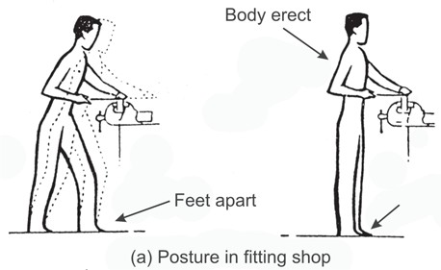
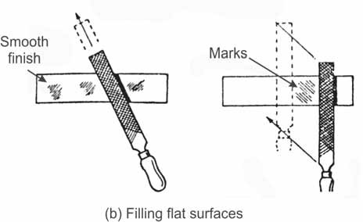
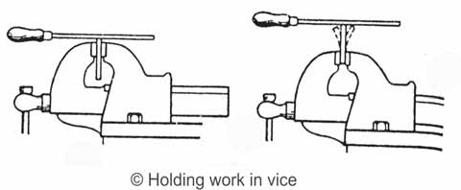
DO’s AND DON’T s OF FITTING PROCESS
The following figures illustrate right and wrong ways of doing certain fitting operations and use of tools.
With left foot set forward the whole of the body is in action and the filing or cutting stroke with pressure is done without much strain to hands or legs. In the second case with body movement the arm would tire soon.
With filing diagonally across the work, smooth finish is obtained. Note that the file moves in the direction of the length of the file as shown. In the second case cut of the file teeth are produced on the work
Keep the work as low in the vise as possible. Work too high means lack of rigidity and too much vibration.
Hold work within the width of the vice jaws, using the full grip of the vice. Avoid unnecessary overhang resulting in poor surface finish.

Slide 27
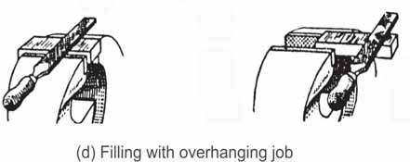

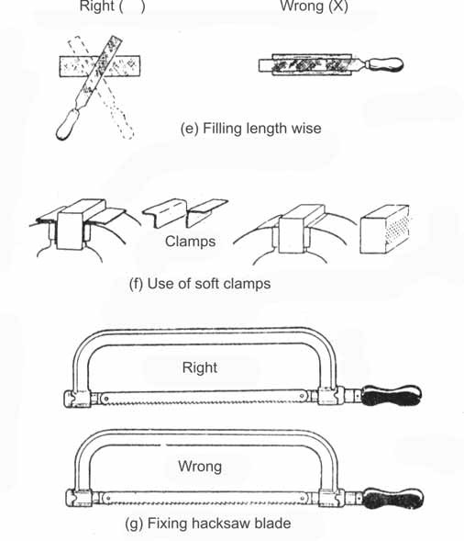
DO’s AND DON’T s OF FITTING PROCESS
Work across at an angle, left and right. It is a mistaken idea that filing along the length of the work produces a flatter surface.
Clamps protect the surface of the finished job. Without clamps jaw impressions are made on the finished surfaces.
Body action applies pressure on forward stroke and relief on return. Blade must be fitted to cut on forward stroke.
Commence cutting with saw blade slightly inclined to the horizontal, picking up the line at far edge of work and proceed to horizontal position.
In the second case it is difficult to pick up line accurately with blade engaging full width of the work.
Blade too steeply inclined results in broken teeth.

Slide 28
STEP MAKING
AIM:
To make step making using Fitting process
SUPPLIED MATERIAL SPECIFICATION
Mild steel plates of specification (50x50x60) mm
APPARATUS REQUIRED:
Hack saw frame with blade
Try square
Steel rule
Caliper
Files
Ball peen hammer
Centre punch
Dot punch

Slide 29
SEQUENCE OF OPERATION
Preparation
Marking
Cutting
Filing
Finishing
Fitting

Slide 30
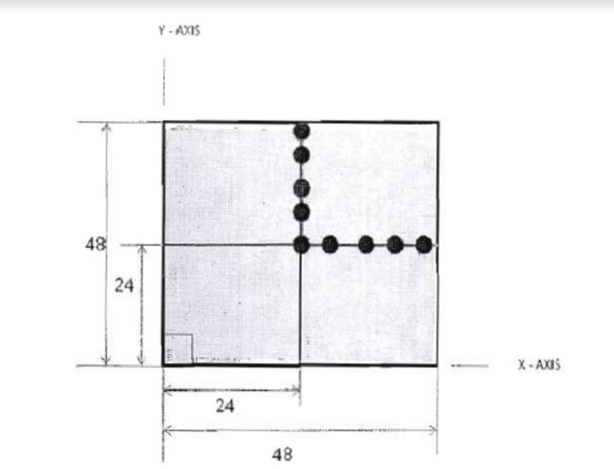
WORKING STEPS
PREPARATION:
Check the initial dimensions using steel rule
Fix the job on a bench vice and file the two adjacent sides using a flat file to form right angles.
Check for the perpendicularity with try square.
2.MARKING
Apply chalk on the work surface
Measure the dimension
Transfer the measured dimension to the work piece
Mark the dimensions on the work piece with one of the filed sides as
reference edge.
Repeat the above steps on other sides.
Scribe lines along the marked dimensions on the work piece.

Slide 31
WORKING STEPS
Mark dots along these lines using dot punch which are called as punch lines.
Draw lines parallel to these punch lines at a distance of 2mm from the, which are called cutting lines.
CUTTING:
Fix the work piece in the bench vice in such a way that the cutting line is perpendicular to the jaws of the vice.
Cut along the cutting lines.
Repeat the steps till cutting id finished along all the cutting lines by rearranging the work piece in the vice.. d) Must ensure that cutting is carried out along all the cutting lines.

Slide 32
FILING
Fix the work piece in the bench vice in such a way that the cutting edges (punch lines) are parallel to the jaws.
File the cut edges using flat rough file to a distance of 2mm, so that the punch lines are exposed.
Remove and refit the work piece in the bench vice to make the next set of cut edges parallel to the jaws.
File the cut edges using flat rough file to a distance of 2mm
Must ensure that filing is carried out along all the cutting edge punch lines
FINISHING
Using a flat smooth file to produce a smooth surface finish In all the filed edges.
FITTING:
Check for true form with a mating gage and for symmetry about the axis with a Vernier caliper.
The fitting accuracy is considered if both contours mate without misalignment and clearances.
RESULT:
Thus a Step Fitting is obtained out of the given work piece with specified dimensions, shape, finish and accuracy with proper fitting.

